Slide 1
The development of the modern operating system
By: Cole Becker
Date: November 23 2023

Slide 2
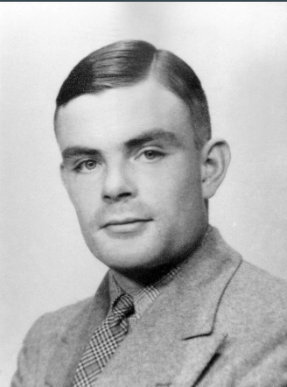
Early Computing - Alan Turing (1912 - 1954)
He invented the turing machine which was a device that could manipulate symbols on a strip of tape according to a table of rules, it was essential in the development of modern computers. His theoretical work helped structure the understanding of computation, algorithms, and the primary principles that support operating systems. He provided the relative basis for the development of early computing systems, which in turn led to the creation of operating systems.

Slide 3

Early Computing - John von Neumann (1903 - 1957)
John Von Neumann designed an architecture in 1945 that introduced the concept of storing program instructions and data in the same memory space, enabling the manipulation of data by instructions. It has forever influenced the design and functionality of operating systems by providing a structure within a computing system for how instructions and data are processed, stored, and managed.

Slide 4
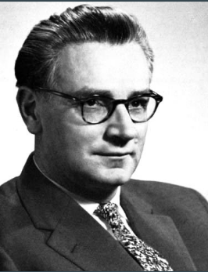
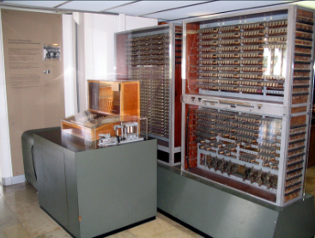
Early Computing - Konrad Zuse (1910 - 1995)
Konrad Zuse is a significant figure in the history of computing, known for creating the world's first programmable computer in 1941 called the Z3. It was groundbreaking at this time and it was capable of executing a series of instructions based on a program stored in memory. He had a role in the foundations of computing, which later contributed indirectly to the development and evolution of operating systems.

Slide 5
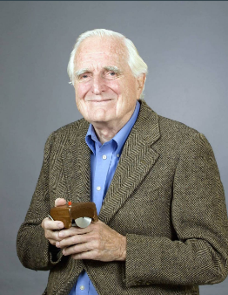
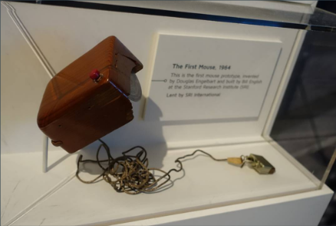
The Mouse
Doug Engelbart invented the computer mouse, a key innovation in computing history. In 1964, while working at the Stanford Research Institute, Engelbart developed the prototype of the computer mouse. It was a simple circuit board and a wooden shell with two metal wheels that could detect movement on a surface. It created a way for us to interact with the GUI on operating systems by nativaging via point and click. It allowed us to select, activate, or drag and drop files on the computer.

Slide 6
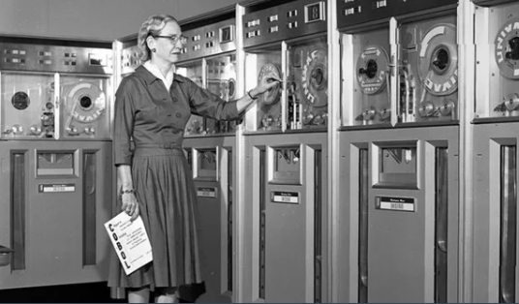
Rise of Mainframes - Grace Hopper (1906 - 1992)
Compiler: One of Hopper's most notable contributions was the development of the first compiler (A-0 System). A compiler translates high level programming languages into machine code that a computer can execute.
COBOL (Common Business-Oriented Language): COBOL is a programming language designed for business and administrative use. It became widely used in the business community and many early operating systems and applications were created using COBOL.
She had a big impact on society because it was her inventions that computers became accessible to a wider range of business and government institutions.

Slide 7
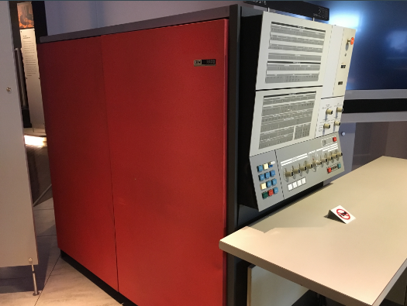
IBM (International Business Machines Corporation)
Founded in 1911, they started off as tabulating machine manufacturing, punch cards, and timekeeping solutions for businesses. Over time, IBM evolved into a global technology and it led to the development of various operating systems, including OS/360/Multics, which offered significant advancements in managing system resources, scheduling tasks, and handling input/output operations. Their impact on society was that their standardization helped wider software compatibility and portability across different hardware, enabling more businesses to adopt computing solutions.

Slide 8
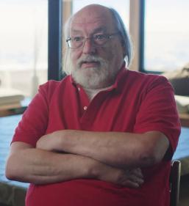

Ken Thompson and Dennis Ritchie
In 1969, they started project Unix on a minicomputer. Ken developed key components of the system, including the file system, shell, and some basic utilities. Dennis collaborated closely with Thompson and made extraordinary contributions to Unix's development. Most importantly, he created the C programming language, which became the main code language for Unix and numerous other operating systems. C had a huge impact in the development of Unix as it allowed for more portable and efficient code.

Slide 9

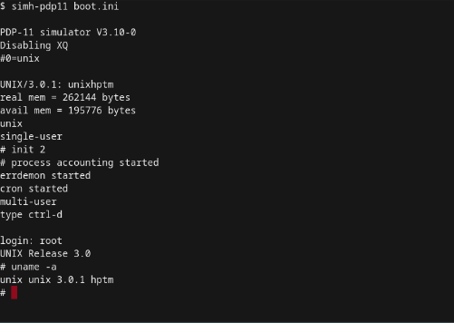
Unix
It introduced the idea of a portable operating system and became a foundation for many future operating systems. The development of the C programming language allowed for more efficient software development for OS. Thompson and Ritchie's contributions not only revolutionized operating systems but also significantly influenced computer science and software engineering

Slide 10
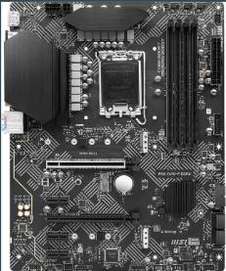
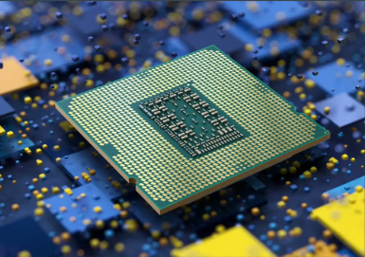
Computer Components
Motherboard: Main circuit board of computer, it holds the CPU, memory and connectors for hard drives. It connects to all the parts of the computer.
CPU (Central Processing Unit) : Often referred to as the brain of the computer, it carries out commands for the computer. Whenever you perform an action, you are sending instructions to the CPU.

Slide 11
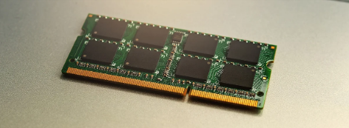
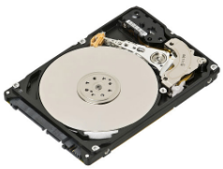
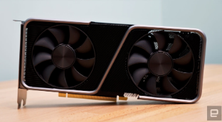
Computer Components
RAM (Random Access Memory): Your systems short term memory. It's the memory that the CPU uses to store data that is actively being used or processed.
Storage Devices: There are several types, including Hard Disk Drives that store data on spinning disks and Solid State Drives that use flash memory for faster data access.
GPU: Used for rendering images, videos and animations, it is necessary for gaming, graphic design, and video editing.

Slide 12
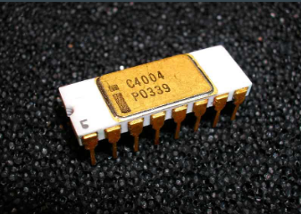
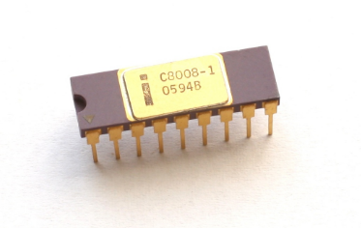
Intel Processors leading to MS-DOS
Intel 4004 (1971): First to put an entire CPU on one chip and the first commercially available microprocessor. It was a 4-bit central processing unit (CPU) and was not specifically designed for personal computers but rather for calculators and similar devices.
Intel 8008 (1972): An 8-bit microprocessor, an improvement over the 4004. It found its way into early computers and terminal systems.

Slide 13
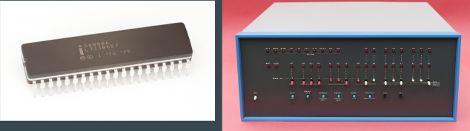
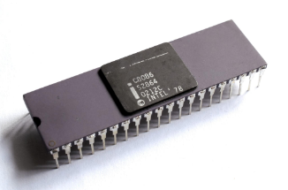
Intel Processors leading to MS-DOS
Intel 8080 (1974): Another 8-bit microprocessor with a significant advancement. It was widely used in the early days of personal computing and was the processor used in the Altair 8800, one of the first commercially successful personal computers.
Intel 8086 (1978): The 16-bit microprocessor that laid the skeleton for the x86 architecture. It was the basis for the IBM PC and IBM PC/XT and was the beginning of the x86 family that would dominate personal computing for decades.

Slide 14
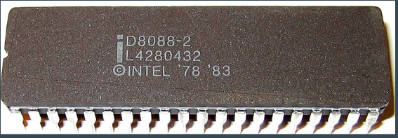
Intel Processors leading to MS-DOS
Intel 8088 (1979): A version of the 8086, it was used in the original IBM PC. It was an 8-bit version of the 8086 and was chosen for cost reasons at the time.
All of these processors laid the groundwork for the development of personal computing and were foundational in the architecture and compatibility that would be crucial for the operating systems, like MS-DOS, to run effectively on these machines.
Microprocessors impacted society because it led to the decrease in size of computers, making them more accessible and affordable.

Slide 15
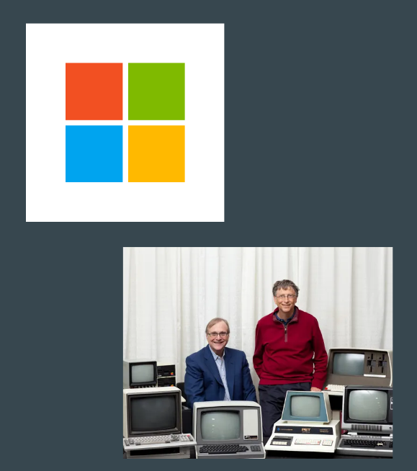
Microsoft
Microsoft has had a huge impact in shaping the history of operating systems and personal computing. It was founded in 1975 by Bill Gates and Paul Allen and they started off creating programming languages and operating systems. They had a deal with IBM to create them an operating system for their new PC’s. They purchased an operating system from seattle computer products and rebranded it as MS-DOS in 1981.

Slide 16
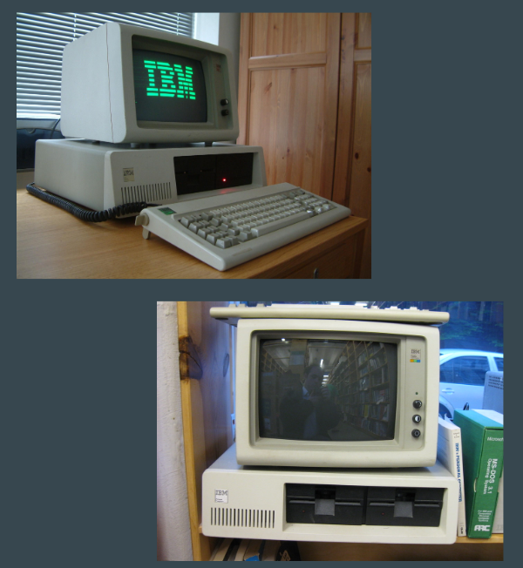
IBM PC’s
IBM PC’s were released in 1981, and worked with microsoft to develop the DOS operating system and were powered by intel's 8088 processor. What made it particularly significant was its open architecture, which allowed third-party developers to create hardware and software for it. Their design and open standards heavily influenced the growth of the computer industry. This set the standard for what we have come to know today in the newer operating systems today.

Slide 17
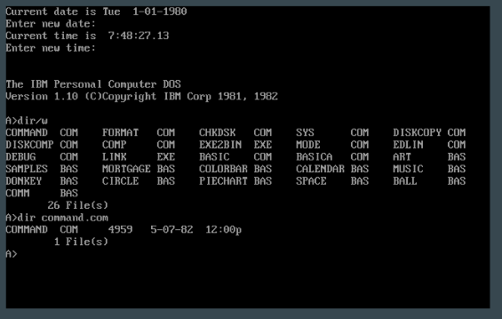
MS-DOS (Disk Operating System) - First operating system
MS-DOS was a command-line-based operating system developed by Microsoft and was one of the first widely used operating systems for IBM-compatible personal computers in the 1980s. It served as a platform for early personal computers. It had no graphical interface and had very limited multitasking combabilities. It required users to manually manage system resources and wasn't very user-friendly and had limited functionality. It impacted society because its simplicity and capability with IBM led to having a rapid growth in PC’s. People started to use computers on a daily basis.

Slide 18
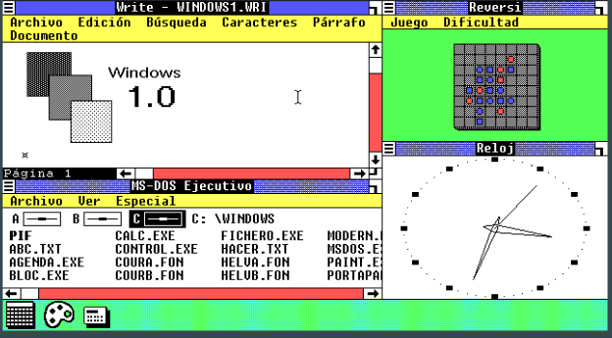
Windows 1.0-3.1
In 1985, microsoft released windows 1.0 to compete against the very popular macintosh. This OS brought GUI and macintosh features over to DOS compatible computers. However, it wasn’t very successful due to its primitive GUI and lack of multitasking. Windows 3.1 launched in the early 90’s and had a significant improvement offering better multitasking and a more intuitive GUI. It became very popular and laid the groundwork for following versions.

Slide 19
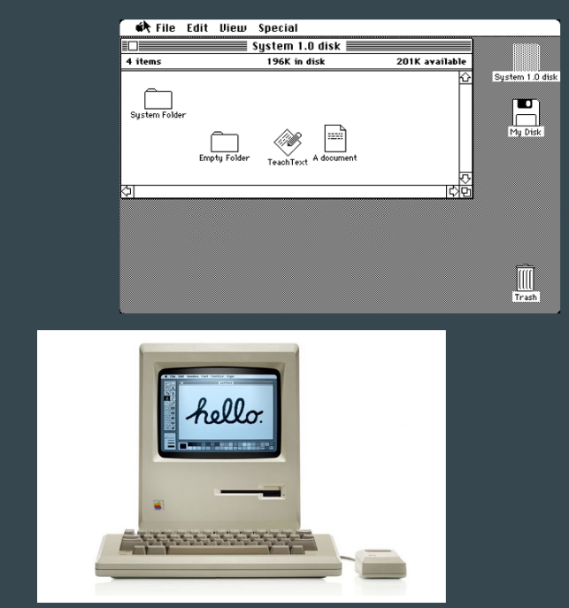
Apple - Macintosh
Apple was founded in 1976 by Steve Jobs, Steve Wozniac and Ronald Wayne. In 1984, during the superbowl apple, released the macintosh. It was the first successful operating system that had a graphical user interface which allowed users to interact with the computer through various mouse buttons, pull down menus and other on screen images instead of a command line. It had more advanced hardware than the IBM and by the end of the decade it allowed users to even multitask. It impacted society by the concept of mouse-driven navigation and visual elements, setting a standard for future operating systems like Windows.

Slide 20

Computer Policies on Environment
Energy efficient settings: Set computer into energy saving modes such as sleep or hibernate and to remember to turn it off when after hours to save energy.
Electronic recycling programs: certified recycling facilities to ensure that all old hardware and components are recycled correctly to minimize e waste.
Data Center Efficiency: Policies may target data centers, aiming to improve their energy efficiency.
Telecommuting and Remote Work: Encouraging telecommuting and remote work policies reduces the need for commuting, thereby decreasing carbon emissions.

Slide 21
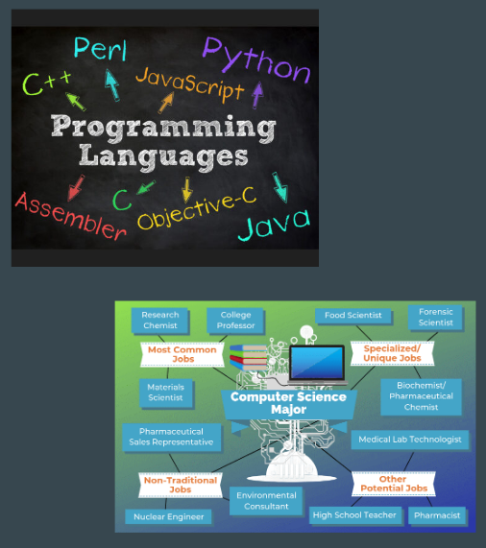
Postsecondary Education - Computers
Postsecondary education related to computers typically involves a range of academic paths, from certificates and associate degrees to bachelors, masters, and doctoral degrees. These programs often cover computer science, information technology, computer engineering, software development, cybersecurity, data science, web developer, game designer, computer network architect and so much more!

Slide 22
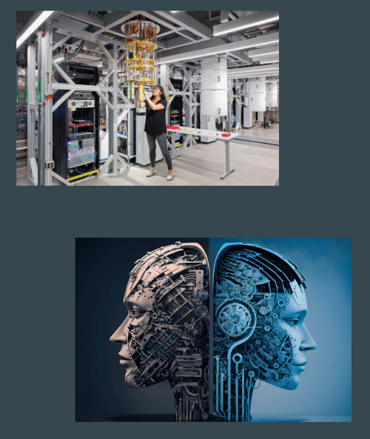
Emerging Areas in Computer Science
Quantum Computing: Developing computers based on quantum mechanic principles to test computations at incredibly high speeds.
Artificial Intelligence: Create computal systems that are intelligent in planning, decision making and other complex tasks.
Machine Learning: Enhancing the capabilities and efficiency of machine learning algorithms.

Slide 23

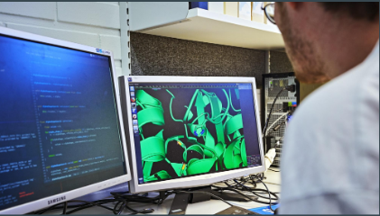
Emerging Areas in Computer Science
Cybersecurity: Protect digital systems, networks, and data from malicious attacks and threats.
Biocomputing: Using computational methods to understand biological systems and solve biological problems.
Robotics: Developing machines capable of performing tasks autonomously and interacting with the environment.

Slide 24
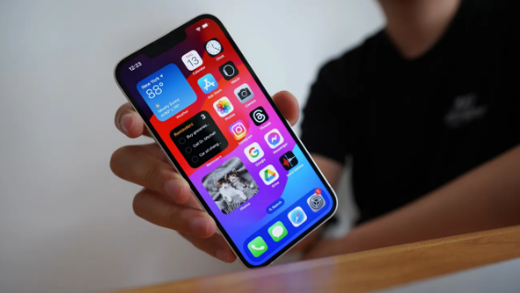
Conclusion
We see OS’s everyday from anywhere from the computer to even our smartphones
These developments significantly impacted society by presenting computing, making it more accessible and user-friendly. They transformed computers from complex machines used by experts to tools accessible to the general public, fueling the digital revolution that continues to shape our world today. We need these operating systems on a daily basic to perform our daily tasks like gaming, work, education and communication and it is all thanks to the work and all the inventions of companies and our early day pioneers.

Slide 25
References
https://en.wikipedia.org/wiki/MS-DOS
https://www.encyclopedia.com/science/encyclopedias-almanacs-transcripts-and-maps/development-computer-operating-systems
https://en.wikipedia.org/wiki/Intel_4004
https://en.wikipedia.org/wiki/IBM_Personal_Computer
https://en.wikipedia.org/wiki/Mac_(computer)
https://en.wikipedia.org/wiki/History_of_Microsoft
https://en.wikipedia.org/wiki/Douglas_Engelbart
https://en.wikipedia.org/wiki/Grace_Hopper

Slide 26
References
https://en.wikipedia.org/wiki/Microsoft
https://www.cnet.com/pictures/microsoft-windows-through-the-years-version-1-0-to-windows-11/6/
https://www.redhat.com/en/blog/has-operating-system-become-modern-day-utility#:~:text=The%20operating%20system%20helps%20us,time%20components%2C%20and%20device%20drivers
https://en.wikipedia.org/wiki/John_von_Neumann
https://en.wikipedia.org/wiki/Z3_(computer)
https://en.wikipedia.org/wiki/Konrad_Zuse
https://www.historyofinformation.com/detail.php?id=872
https://en.wikipedia.org/wiki/Apple_Inc.
https://edu.gcfglobal.org/en/computerbasics/inside-a-computer/1/

Slide 27
References
https://tecnet.ca/about-us/environmental-stewardship/r
https://insights2techinfo.com/12-most-emerging-research-areas-in-computer-science-in-2021/
https://www.ontariovirtualschool.ca/post-secondary-pathways-computer-sciences/

